Slide 1


Slide 2
Group Members:
Rakay Shahid (172076)(Group Leader)
Amaan Shafique (172042)
Hashir Kayani (172065)
Albash Khan (172068)
Mohammad Shaokat (172054)
Abdul Mateen Younas (172107)

Slide 3
Land Mark

Slide 4
Tools Used
Sublime Text – Code Editor (<3)
Xampp – Php and MarieDB
AdminLTE – Admin Panel

Slide 5
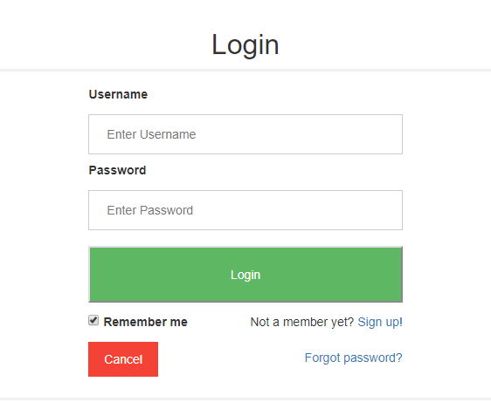
Login Page
Features
Does not take empty inputs
Takes normal users to website and Admin to Admin Panel
Alerts on Username/Password mismatch

Slide 6
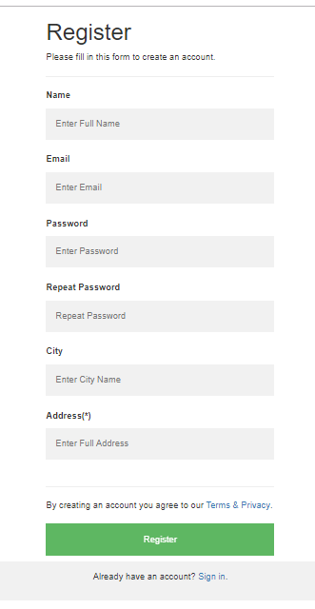
Register Page
Features
Does not take empty inputs
Does not take same Usernames
Encrypts Password for security

Slide 7
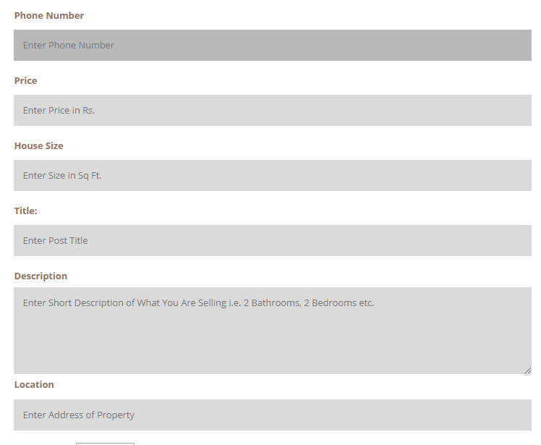
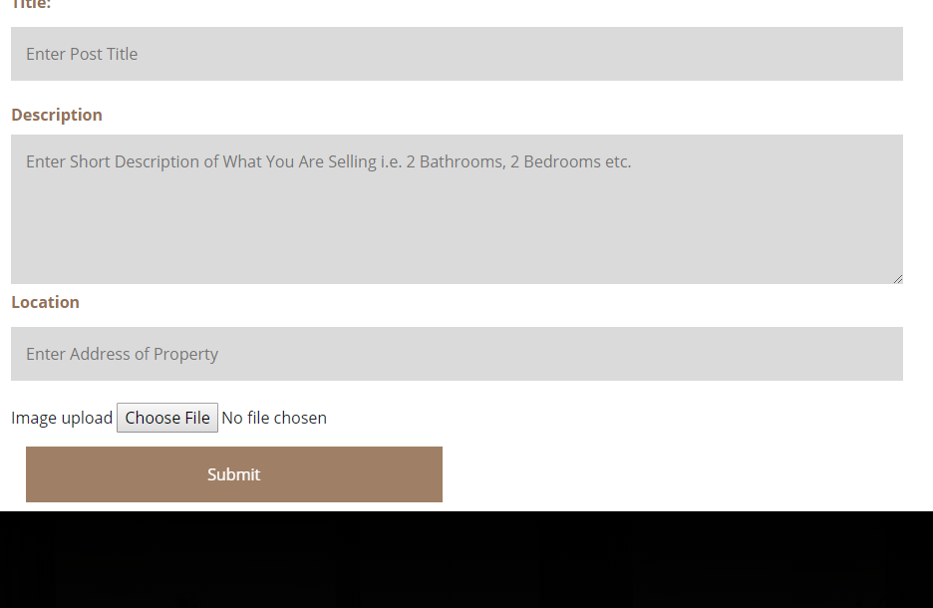
Post Creation Form

Slide 8
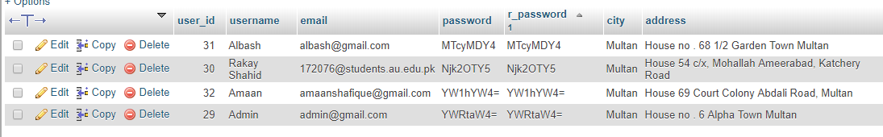
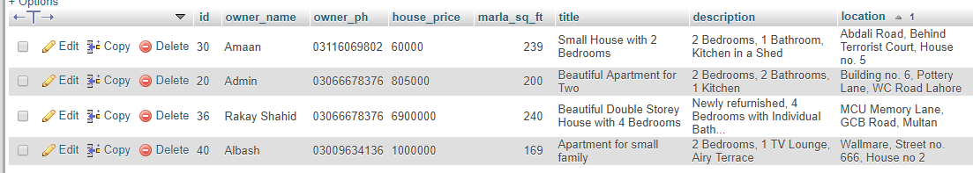
Tables
User
Houses

Slide 9
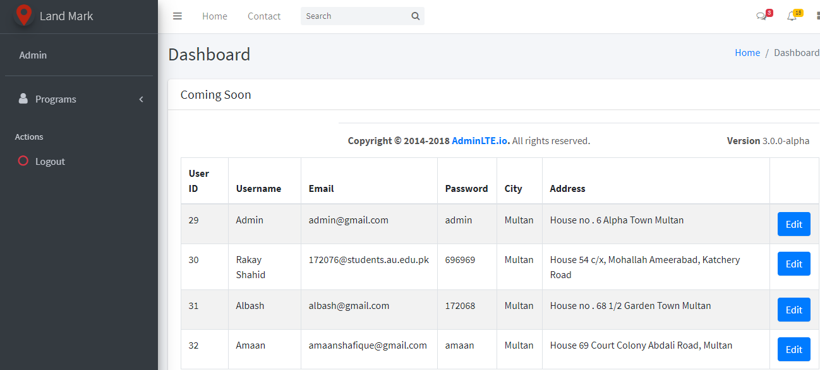
Admin Panel

Slide 10
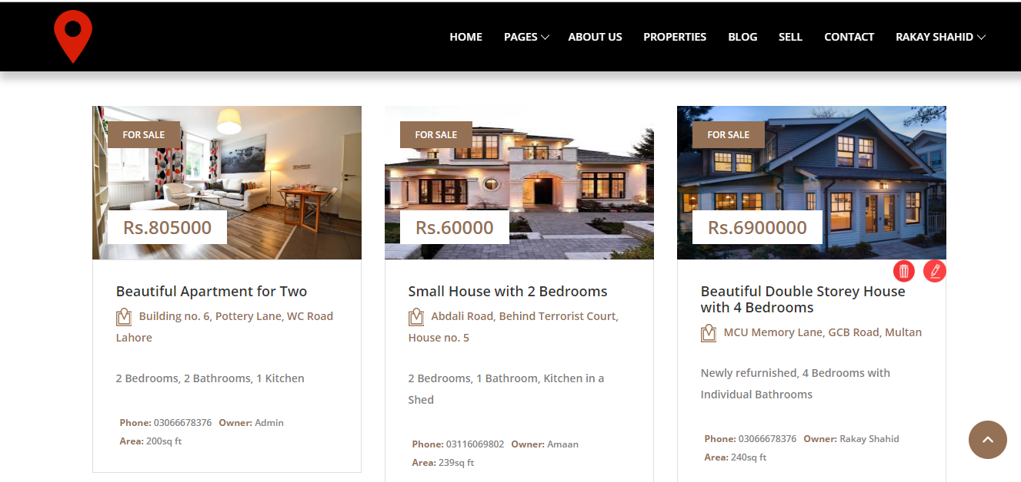
List of Properties

Slide 11
Difference b/w Users and Admin

Slide 13
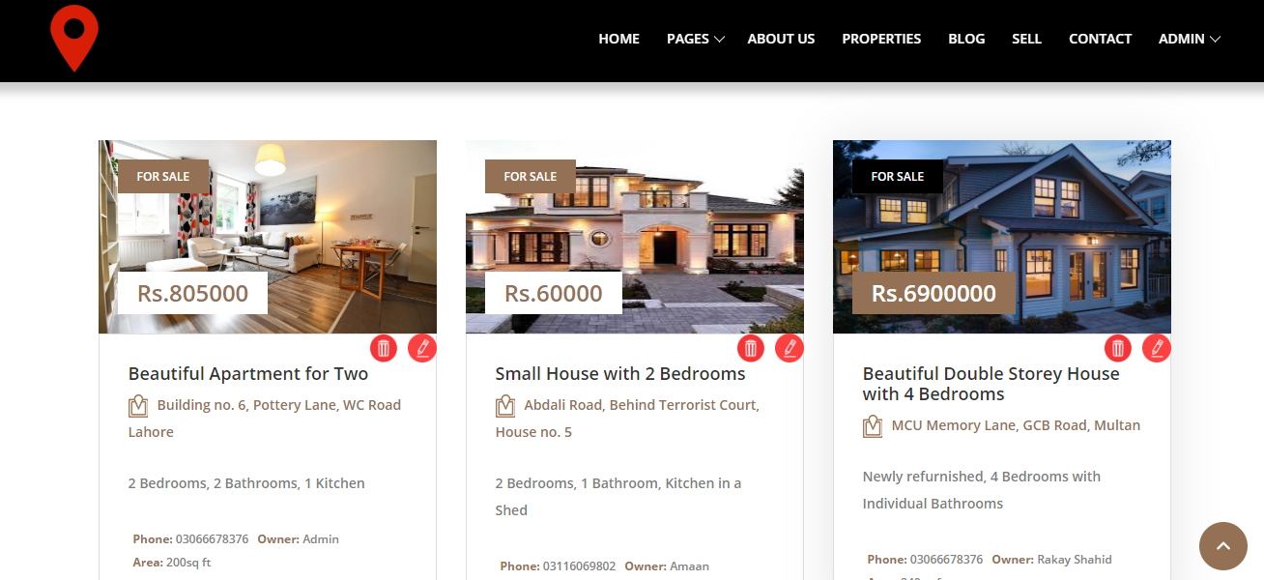

Slide 14
Want A Demo?

Slide 15
Thank you

